Slide 1

Hybrid Deep Learning for Lung Sound Classification in Respiratory Disease Detection
Presented by,
Harsh,125156040
Vedant Agnihotri,125003388
Guided by,
Dr. Vidivelli S
Assistant Professor-II,School of Computing

Slide 2
Abstract
Respiratory diseases, such as COPD, pneumonia, and URTI, significantly impact global health and require efficient diagnostic methods for early detection and management. This project introduces an advanced deep edge intelligence system for real-time respiratory disease detection, leveraging deep learning models for automated lung sound classification.
A key novelty of this work lies in the integration of Resnet-18 architectures to enhance feature representation and capture deeper temporal dependencies in lung sounds. By combining these architectures with LSTM for feature extraction from short-time Fourier transform (STFT) spectrograms, the model improves the classification of four lung sound types—normal, crackles, wheezes, and both crackles and wheezes. Additionally, the study employs the focal loss (FL) function to address training data imbalance, ensuring a more effective learning process. The proposed model is trained and validated using the ICBHI 2017 Respiratory Sound Database under three different data splitting strategies to ensure robustness and generalization.
This project aims to develop a portable and efficient diagnostic tool suitable for edge computing environments, ensuring accessibility for real-world healthcare applications. It integrates feature extraction techniques, including CNN-LSTM, for robust classification while leveraging data augmentation and optimization strategies to enhance system performance. Future directions include real-world deployment and further refinement to bridge the gap between advanced medical diagnostics and practical healthcare solutions, particularly for resource-limited settings.

Slide 3
Base Paper Details
Georgios Petmezas, Grigorios-Aris Cheimariotis, Leandros Stefanopoulos , Bruno Rocha, Rui Pedro Paiva, Aggelos K. Katsaggelos & Nicos Maglaveras ,“Automated Lung Sound Classification Using a Hybrid CNN-LSTM Network and Focal Loss Function”,Journal of Sensors, Volume 22, 2022, Number 1232
Indexed in : Scopus
Year of Journal base paper publication : 2022

Slide 4
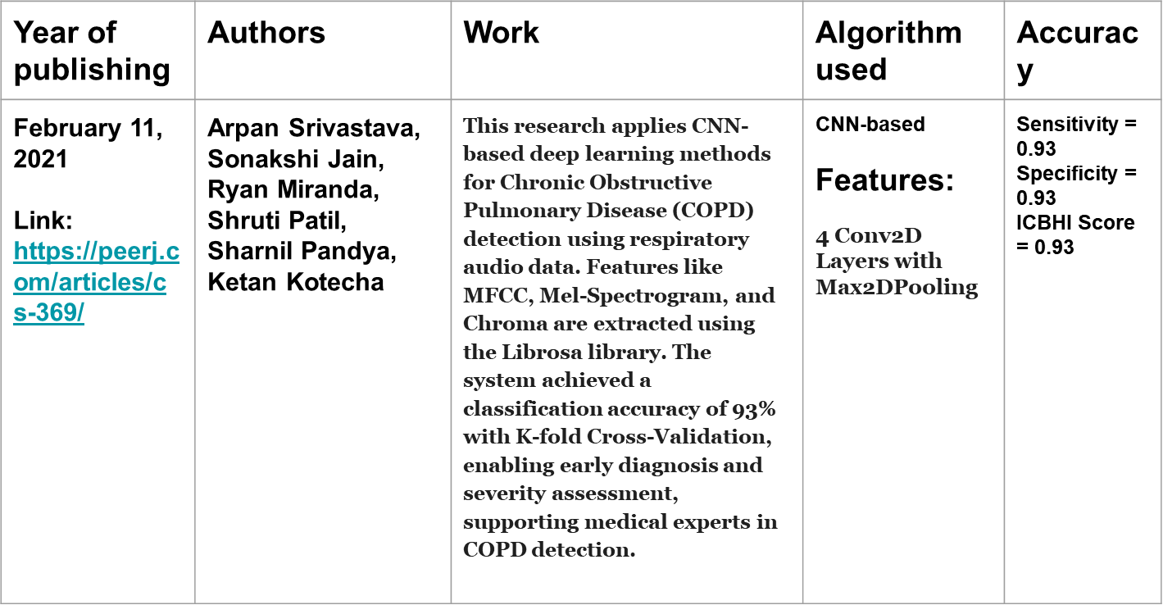
Literature Survey

Slide 5
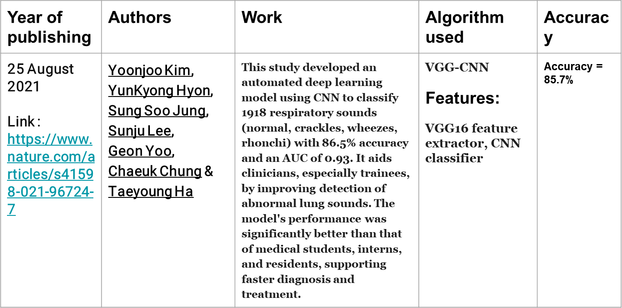
Literature Survey

Slide 6
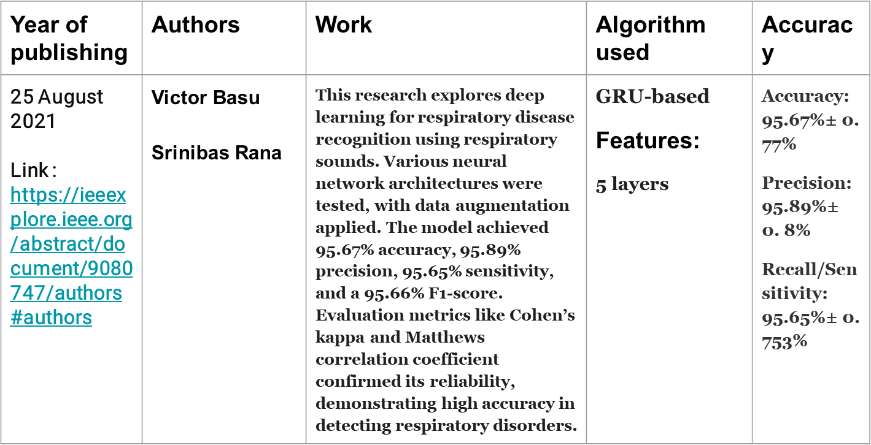
Literature Survey

Slide 7
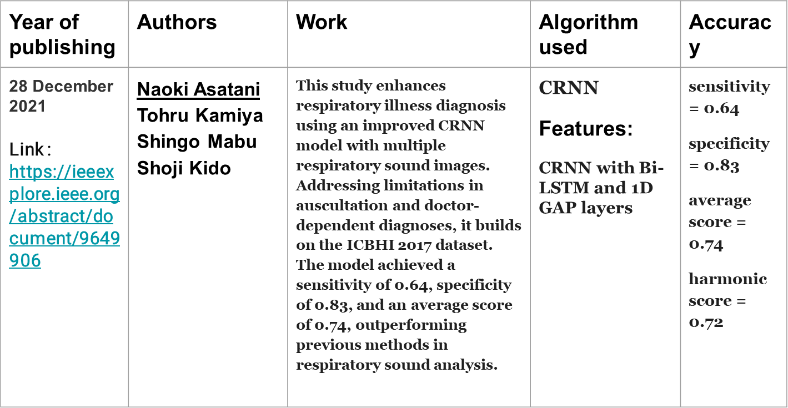
Literature Survey

Slide 8
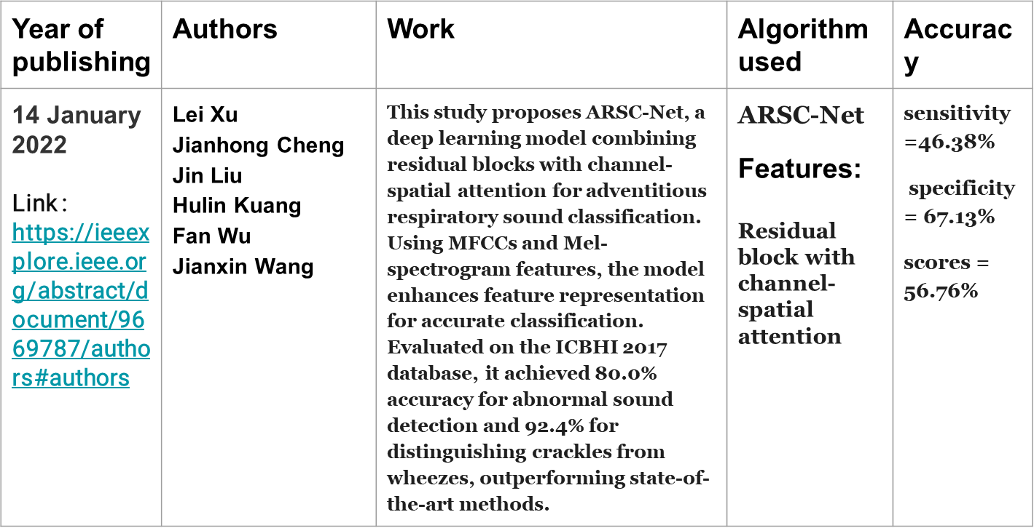
Literature Survey

Slide 9
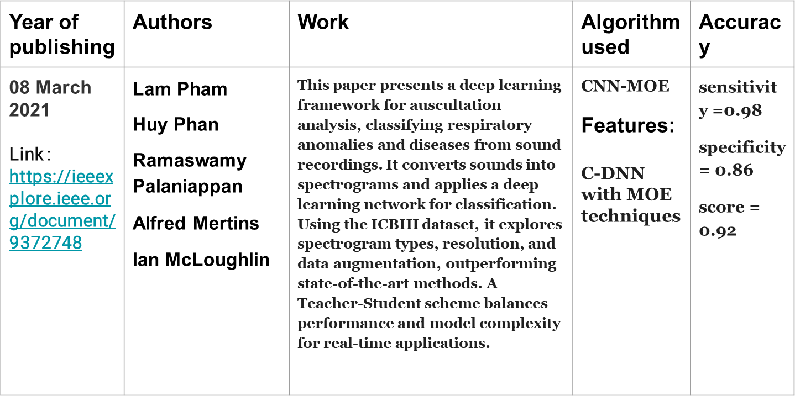
Literature Survey

Slide 10
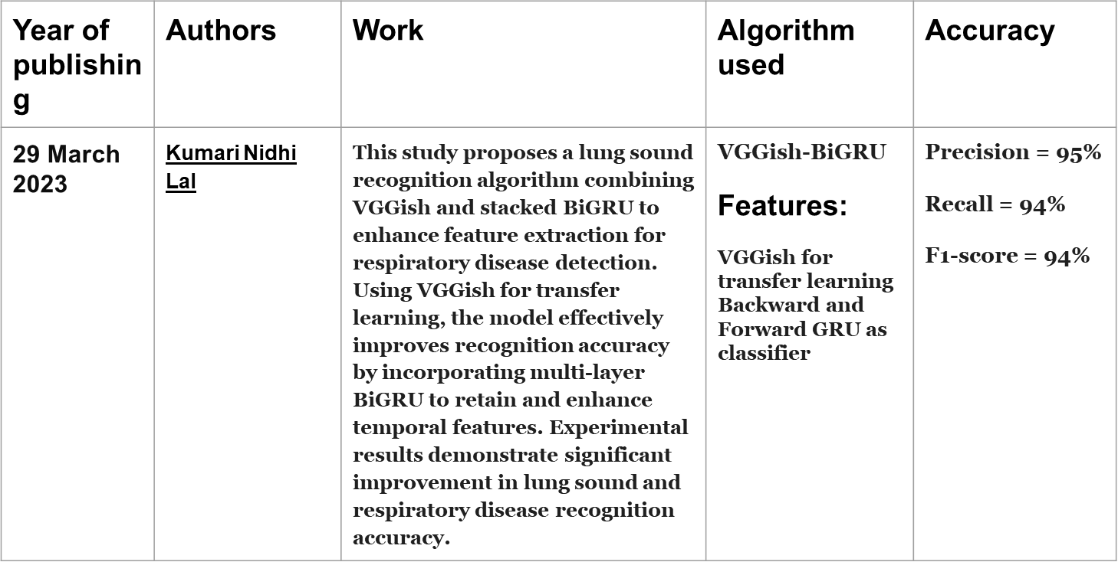
Literature Survey

Slide 11
Existing Systems
Traditional Lung Auscultation:
Physicians use a stethoscope to diagnose respiratory diseases.
Relies on expertise, making it subjective and inconsistent.
Prone to interference from background noise and environmental factors.
Machine Learning-Based Approaches:
Uses models like SVM, HMM, and GMM with handcrafted features.
Improves over manual auscultation but requires extensive feature engineering.
Struggles with generalization and class imbalance.
Deep Learning-Based Approaches:
CNNs, RNNs, LSTMs, and ResNets analyze lung sound spectrograms.
Reduces manual feature extraction but faces data imbalance issues.
Performance is affected by limited labeled datasets and noise interference.

Slide 12
Drawbacks of Existing System
1.Data Privacy and Bias in Deep Learning Models:
Deep learning models require large datasets containing sensitive patient information, raising privacy concerns.
Potential bias in models due to non-representative training data can lead to misdiagnosis, affecting healthcare equity.
2. Accuracy and Performance Issues:
The model shows imbalanced sensitivity and specificity, affecting classification reliability.
Data imbalance leads to poor detection of less frequent lung sound categories.

Slide 13
Proposed Systems
Step | Process | Techniques Used
01. Data Collection and Preprocessing | - Collect respiratory sound recordings from the ICBHI 2017 dataset. - Apply Short-Time Fourier Transform (STFT) to convert audio signals into spectrograms. - Normalize and segment respiratory cycles for uniform input processing. | - ICBHI 2017 dataset - STFT spectrogram conversion - Data normalization & segmentation
02. Model Selection and Training | - Train models for different data types. - Implement focal loss to handle class imbalance. | - Lung Sounds: CNN, LSTM, CNN-GRU, VGGish - Feature Embeddings: CNN for STFT spectrograms - Loss Function: Focal Loss
03. Feature Fusion and Classification | - Merge deep feature embeddings from different models. - Use fully connected layers for classification. | - CNN, LSTM, CNN-GRU, VGGish - Fully connected layers for classification
04. System Optimization | - Apply data augmentation techniques to improve generalization. - Optimize model using pruning, quantization, and hyperparameter tuning. | - Data augmentation - Model pruning & quantization - Hyperparameter tuning
05. Evaluating and Comparing Models | - Evaluate models using different validation strategies. - Compare performance for sensitivity and specificity improvements. | - 60/40 Split - 10-fold Cross-Validation - Leave-One-Out Validation

Slide 14
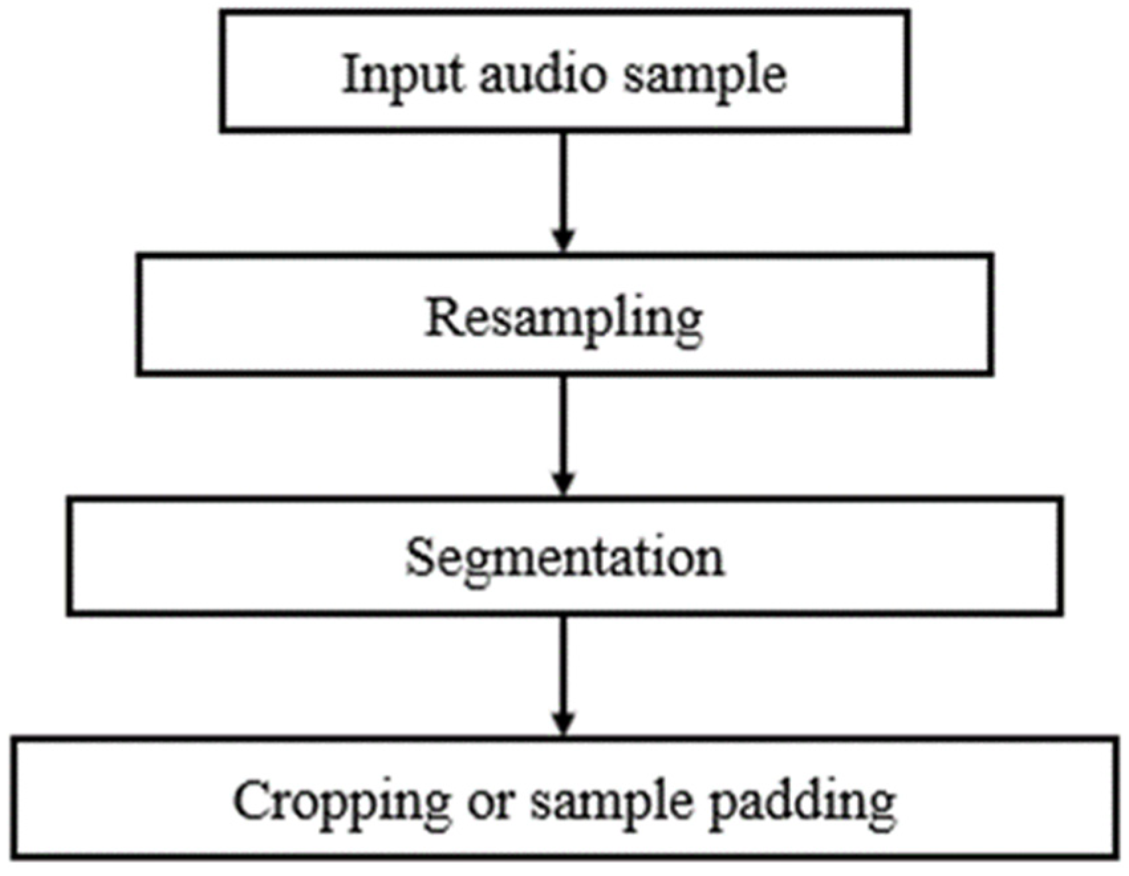
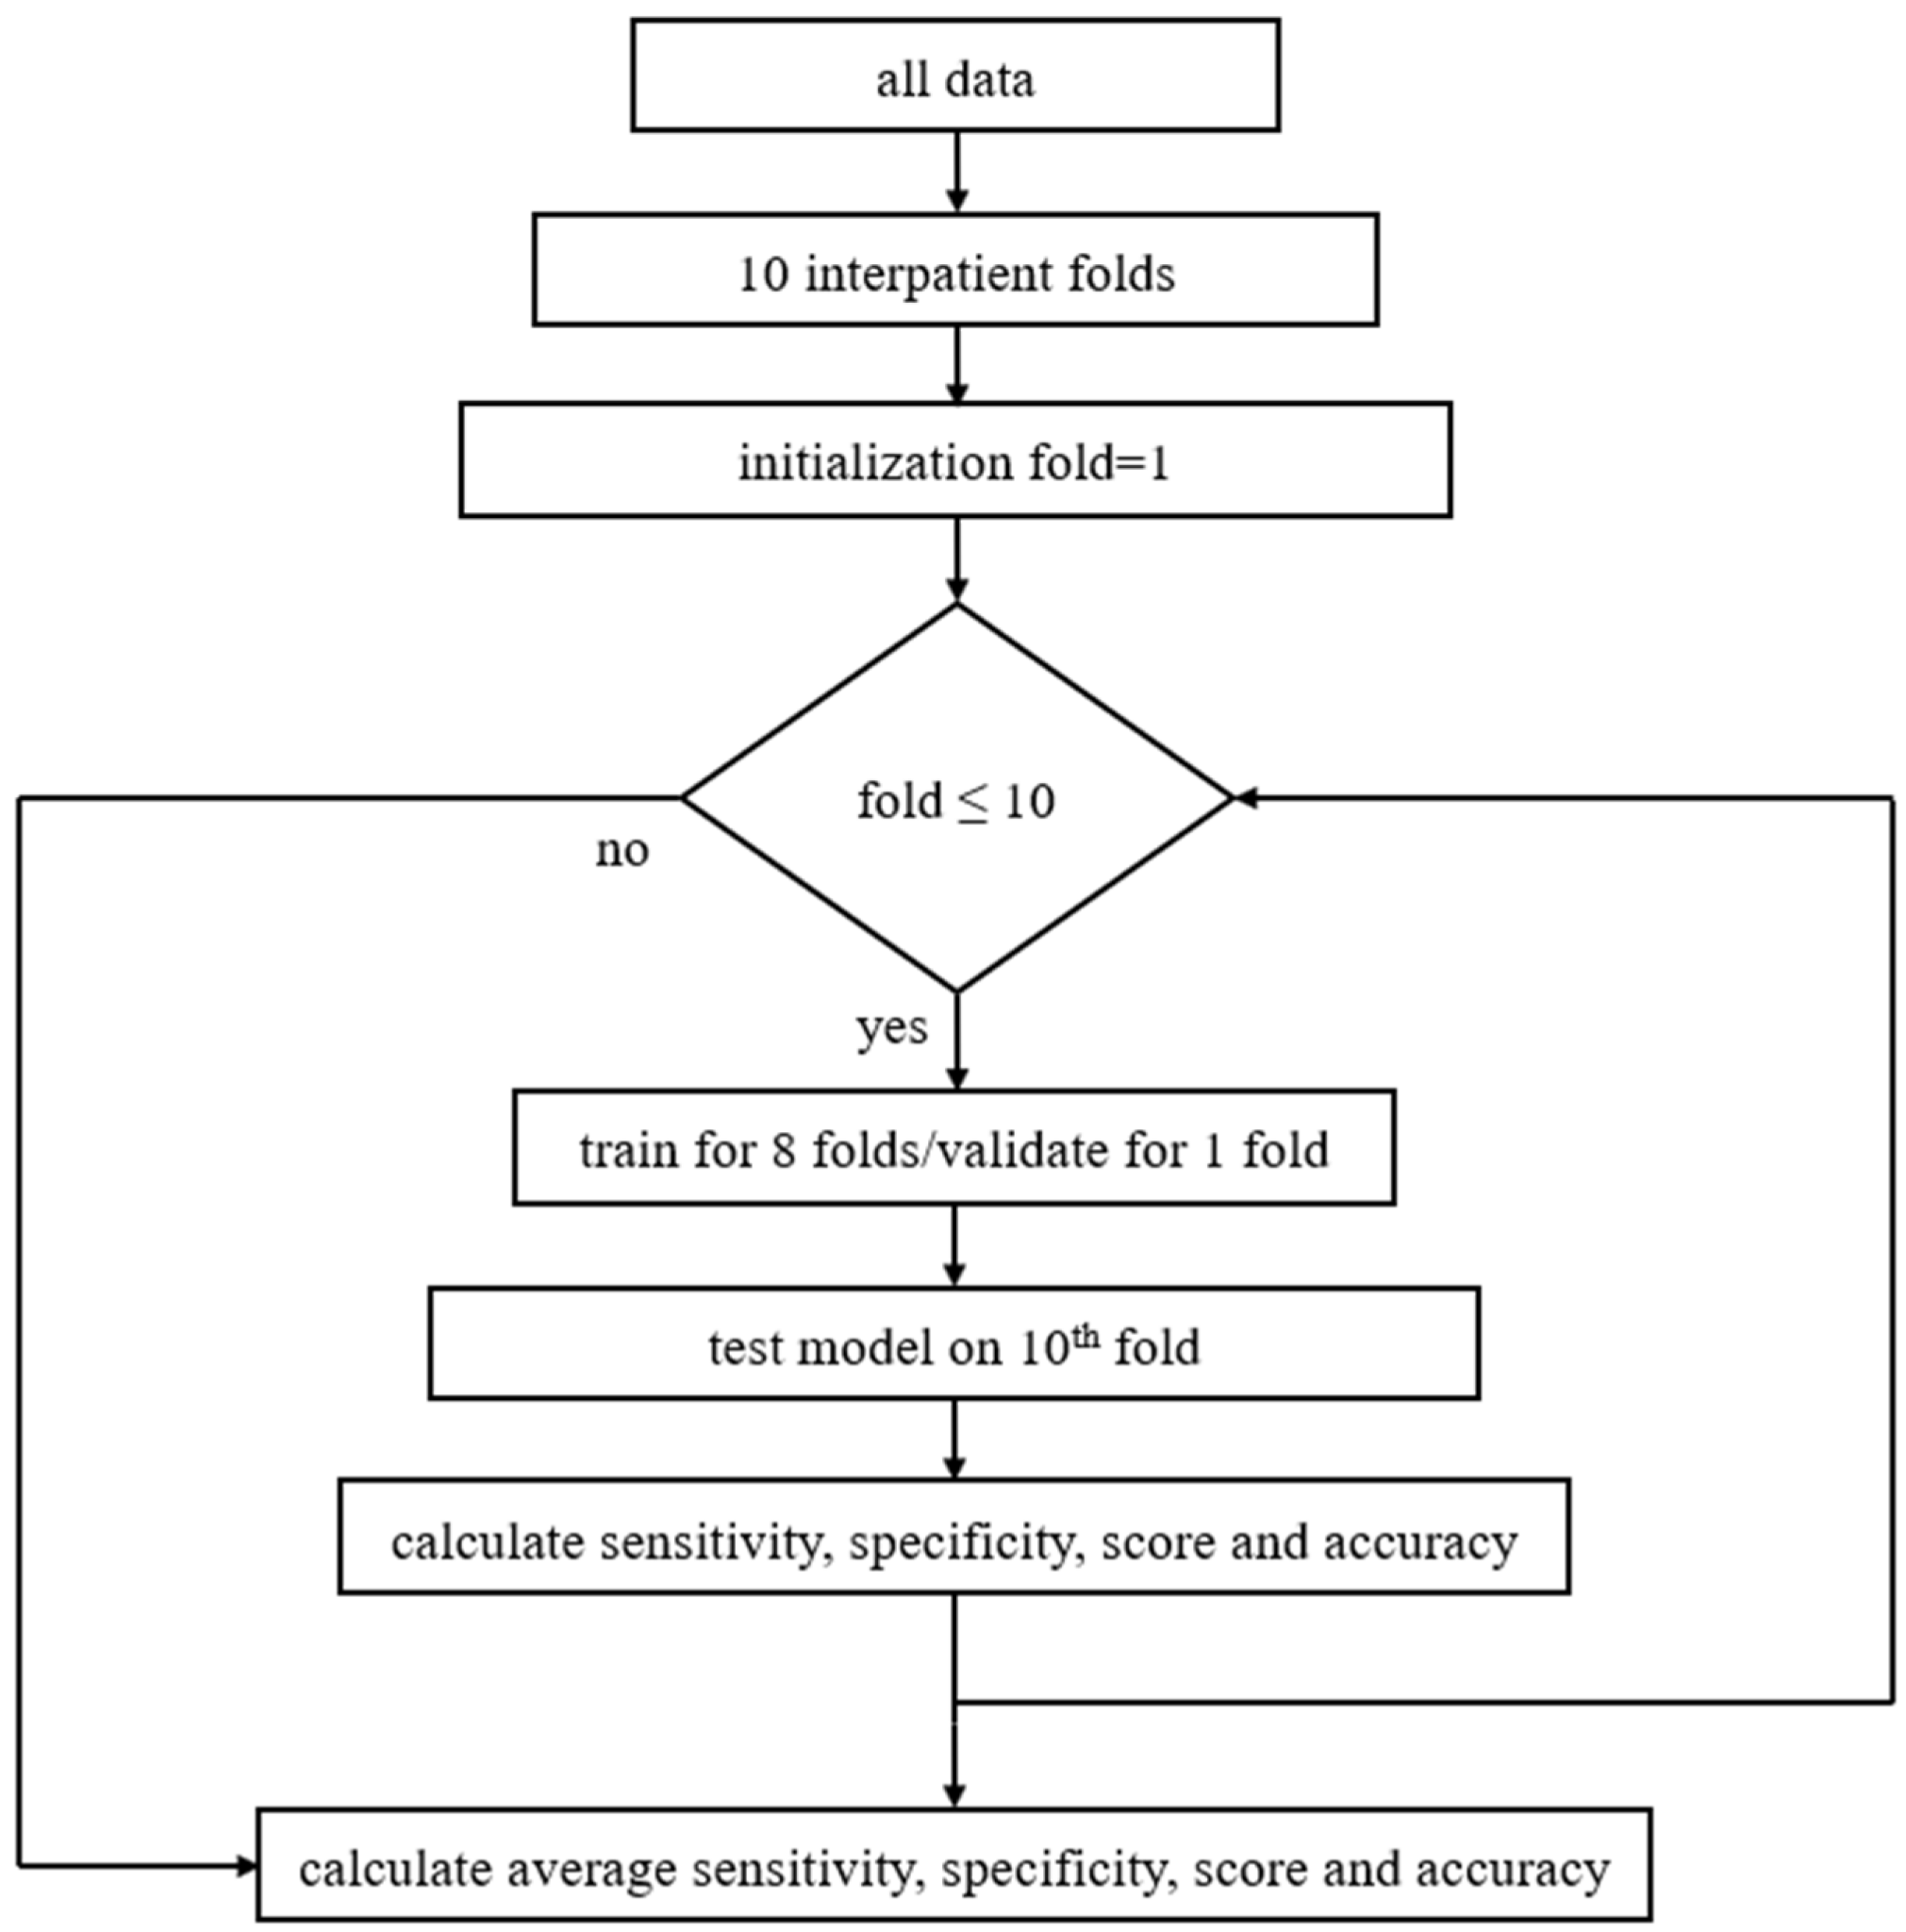
Workflow

Slide 15
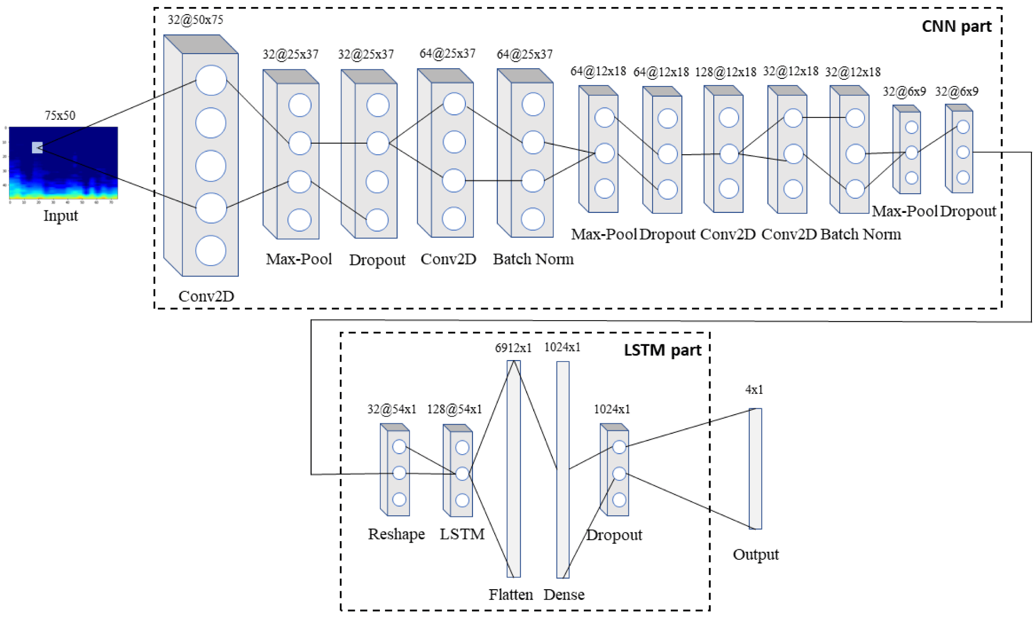
Workflow Diagram

Slide 16
Modules and Algorithms
Module 1 : Data Preprocessing
The preprocessing pipeline includes:
Resampling: Audio samples are resampled to 4000 Hz.
Segmentation: Resampled signals are segmented into distinct respiratory cycles.
Fixed Duration Extraction: Respiratory cycles are either cropped or padded to create fixed-duration samples.
Module 2 :Training and Evaluation
The model was trained and evaluated using:
10-fold Cross-Validation: Interpatient 10-fold cross-validation was used to ensure reliable results.
Leave-One-Out Cross-Validation (LOOCV): Used as an additional evaluation method.
Official 60/40 Split: The model was also evaluated using the official ICBHI dataset split.
Module 3 : Key Algorithms used
CNN-LSTM Architecture
The model combines a Convolutional Neural Network (CNN) and Long Short-Term Memory (LSTM) network in a hybrid architecture:
CNN Module: Extracts features from short-time Fourier transform (STFT) spectrograms of lung sound recordings.
LSTM Module: Processes the features extracted by the CNN to identify and memorize long-term dependencies in the data.

Slide 17
Dataset Description
The ICBHI Respiratory Sound Database (2017) Dataset from Kaggle .
A total of 5.5 hours of recordings containing 6898 respiratory cycles .
1864 contain crackles, 886 contain wheezes and 506 contain both crackles and wheezes
920 .wav sound files & 920 annotation .txt files
Link - https://www.kaggle.com/datasets/vbookshelf/respiratory-sound-database

Slide 18
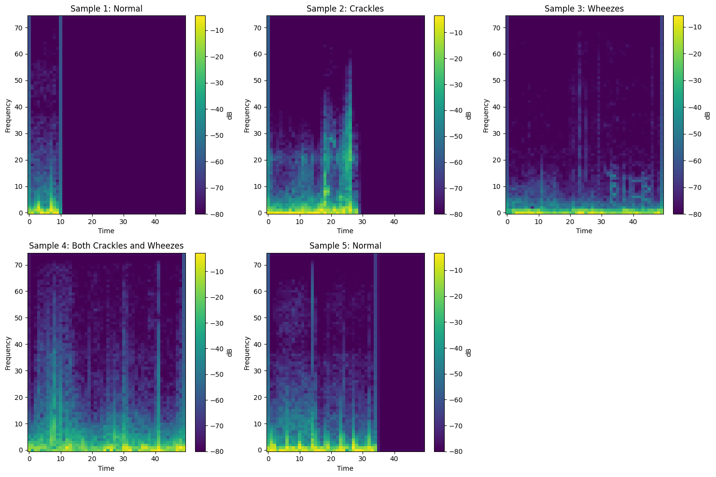
Dataset

Slide 19
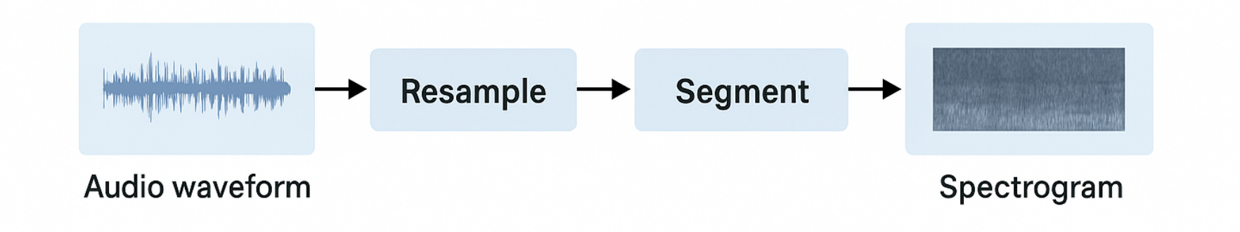
Preprocessing
Downsample to 4000 Hz
Segment into cycles via annotations
Pad/Crop to fixed 2.7s duration

Slide 20
Feature Extraction with STFT
Time-domain to frequency-time spectrogram via Short-Time Fourier Transform (STFT)
Output: 75x50 grayscale
spectrograms
Used as 2D image input for
CNN

Slide 21
Base Paper Model – CNN + LSTM
Architecture:
4 Conv layers → Max Pool → BatchNorm → Dropout
LSTM for temporal feature learning
Dense + Softmax for classification
Focal Loss for handling imbalance
Base Paper Performance (10-Fold Interpatient CV):
Accuracy: 76.39%
Sensitivity: 52.78%
Specificity: 84.26%
Score: 68.52%

Slide 22
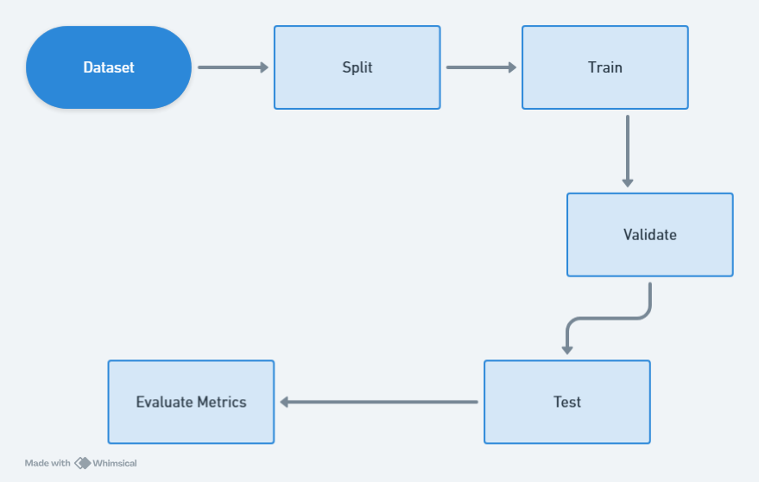
Training & Evaluation Strategy
Data Splits Used:
60/40 Holdout
10-Fold Interpatient Cross Validation
Leave-One-Out Cross Validation (LOOCV)
Metrics:
Accuracy
Sensitivity (True positive rate)
Specificity (True negative rate)
Score (avg of Sens & Spec)

Slide 23
Proposed Model – ResNet-18 + LSTM
Enhancements:
ResNet-18 as CNN backbone
Skip connections → Better gradient flow
Combined with LSTM and Focal Loss
Layer | Type | Output
Input | Spectrogram (75x50x3)
ResNet-18 | Deep CNN | Feature Maps
LSTM | Sequential Model | Vector
Dense | Fully Connected | 4-class softmax

Slide 24
ResNet-18
Depth: As the name suggests, ResNet-18 has 18 layers. These layers include convolutional layers, batch normalization layers, ReLU activation functions, and fully connected layers. Specifically, it consists of:
1 convolutional layer at the beginning.
4 residual blocks, each containing two convolutional layers (making 8 convolutional layers in the blocks).
Followed by an average pooling layer and a fully connected layer for classification.
Architecture: ResNet-18 primarily uses basic blocks.
Number of Parameters: It has a relatively smaller number of parameters compared to deeper ResNets, making it computationally more efficient and faster to train.
Performance: Generally achieves good accuracy on many image classification tasks. It might be less powerful than deeper networks for very complex datasets with intricate patterns.

Slide 25
ResNet-50
Depth: ResNet-50 is significantly deeper with 50 layers. These include:
1 convolutional layer at the beginning.
16 residual blocks. Most of these blocks are bottleneck blocks.
Followed by an average pooling layer and a fully connected layer for classification.
Architecture: ResNet-50 utilizes bottleneck blocks to reduce computational complexity. Each bottleneck block has a 1x1 convolutional layer to reduce the number of channels, a 3x3 convolutional layer, and another 1x1 convolutional layer to increase the channels back to the original dimension
Number of Parameters: It has a larger number of parameters than ResNet-18 due to its increased depth and the use of bottleneck blocks. This typically leads to higher computational cost and longer training times.
Performance:Generally achieves higher accuracy than ResNet-18 on challenging datasets due to its increased representational capacity, allowing it to learn more complex features.

Slide 26
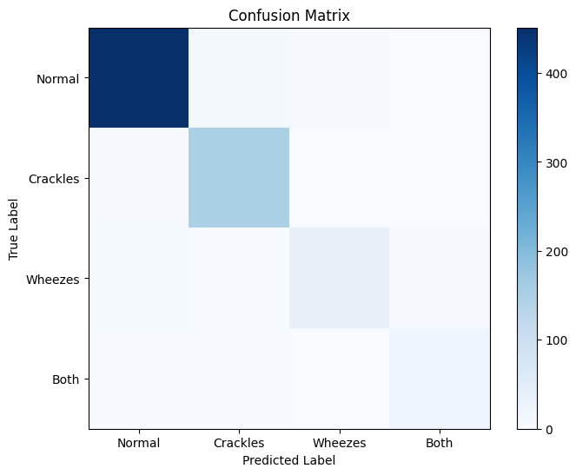
Results Comparison – Base Paper vs. Our Model
Metric | Base Paper (CNN+LSTM) | Our Model (CNN-Mel Spectrogram)
Accuracy | 76.39% | 76.56%
Sensitivity | 52.78% | 68.52%
Specificity | 84.26% | 90.04%
Score | 68.52% | 79.28%

Slide 27
Results Comparison – Base Paper vs. Our Model
Metric | Base Paper (CNN+LSTM) | Our Model (ResNet+LSTM)
Accuracy | 76.39% | 78.04%
Sensitivity | 52.78% | 72.73%
Specificity | 84.26% | 91.43%
Score | 68.52% | 82.08%

Slide 28
Results Comparison – Base Paper vs. Our Model
Metric | Base Paper (CNN+LSTM) | Our Model (ResNet-18)
Accuracy | 76.39% | 80.67%
Sensitivity | 52.78% | 75.71%
Specificity | 84.26% | 92.39%
Score | 68.52% | 84.05%

Slide 29
Results Comparison – Base Paper vs. Our Model
Metric | Base Paper (CNN+LSTM) | Our Model (ResNet-50)
Accuracy | 76.39% | 81.60%
Sensitivity | 52.78% | 76.25%
Specificity | 84.26% | 92.32%
Score | 68.52% | 84.29%

Slide 30
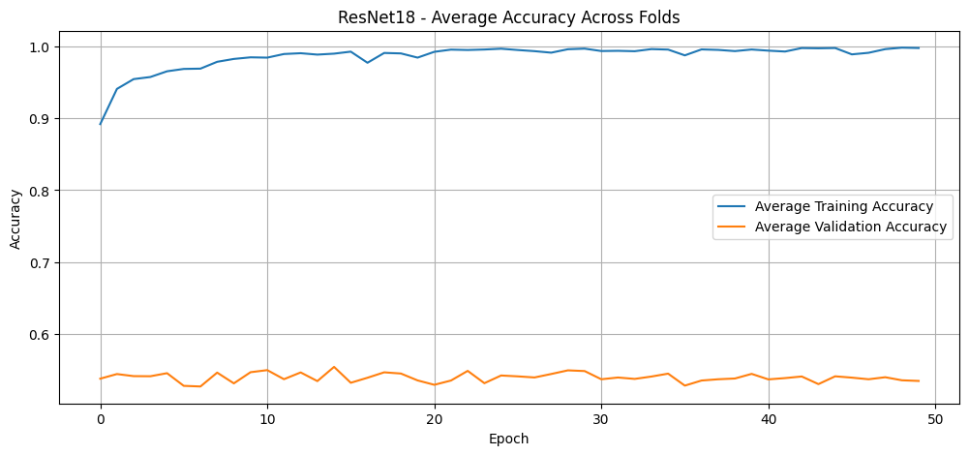
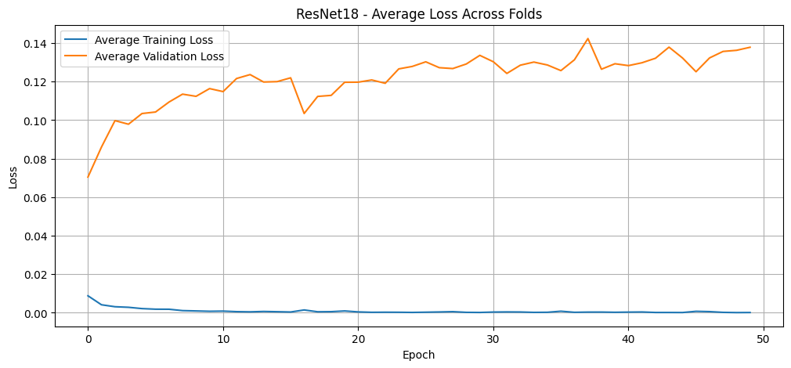
Plots - ResNet18

Slide 31
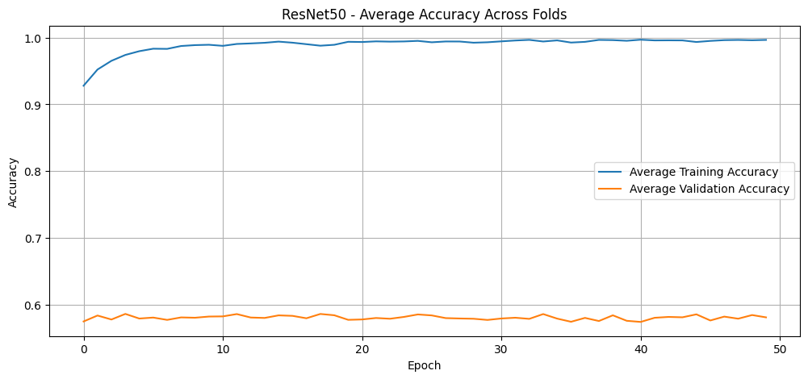
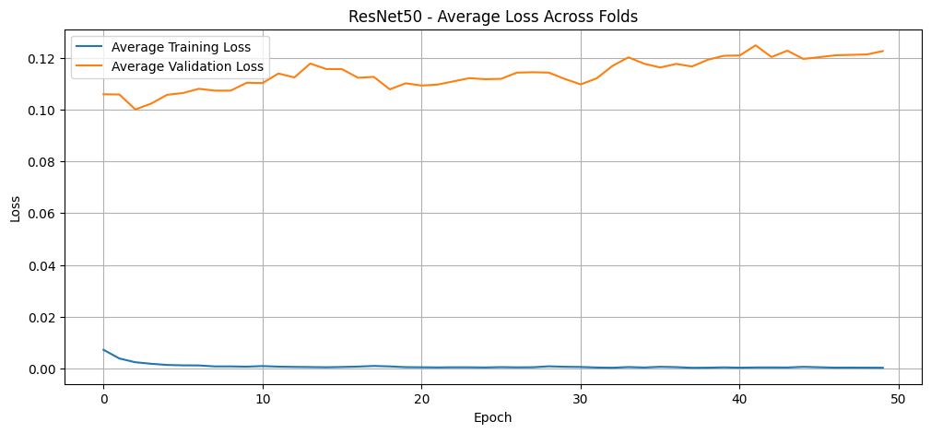
Plots - ResNet50

Slide 32
Conclusion & Future Scope
Conclusion:
ResNet-50 backbone outperforms CNN in feature extraction
Focal Loss effectively handles imbalance
Model generalizes across patient data
Future Work:
Edge device deployment (e.g., Raspberry Pi)
App Deployment or Web Application Deployment
Expand dataset to include more pathologies
Explore hybrid architectures (e.g., Resnet-50+LSTM,CNN-Transformer,etc)

Slide 33
Team Member Responsibility & Timeline
Module 1 - Harsh
Module 2 - Vedant
Module 3 - Harsh & Vedant
Problem Identification - 1/2/25 to 15/2/25
Module 1 - 20/2/25 to 5/3/25
Module 2 - 6/3/25 to 20/3/25
Module 3 - 21/3/25 to 15/4/25
Final modifications & Report preparation - 15/4/25 to 25/4/25

Slide 34
References
“Respiratory sound classification for crackles, wheezes, and rhonchi in the clinical field using deep learning” - https://www.nature.com/articles/s41598-021-96724-7
“Respiratory diseases recognition through respiratory sound with the help of deep neuralnetwork”- https://ieeexplore.ieee.org/abstract/document/9080747/
“Classification of Respiratory Sounds by Generated Image and Improved CRNN”-https://ieeexplore.ieee.org/abstract/document/9649906
ARSC-Net: Adventitious Respiratory Sound Classification Network Using Parallel Paths with Channel-Spatial Attention - https://ieeexplore.ieee.org/abstract/document/9669787/
“Leveraging deep edge intelligence for real-time respiratory disease detection” - https://www.sciencedirect.com/science/article/pii/S2588914125000012

Slide 35
Thank you

